Slide 1

“Preparing individual meals for you”
E-Business Proposal - SMAD 407
18 November, 2019
Madisen Divine, Jordan Edmonds, Ripleigh Hatfield, David Shull

Slide 2
Company Information
Our company provides fresh, portioned ingredients for meals that are fit perfect for one person.
PortionOne.com

Slide 3


Usability Requirements
Desktop - at home
Mobile - on the go

Slide 4
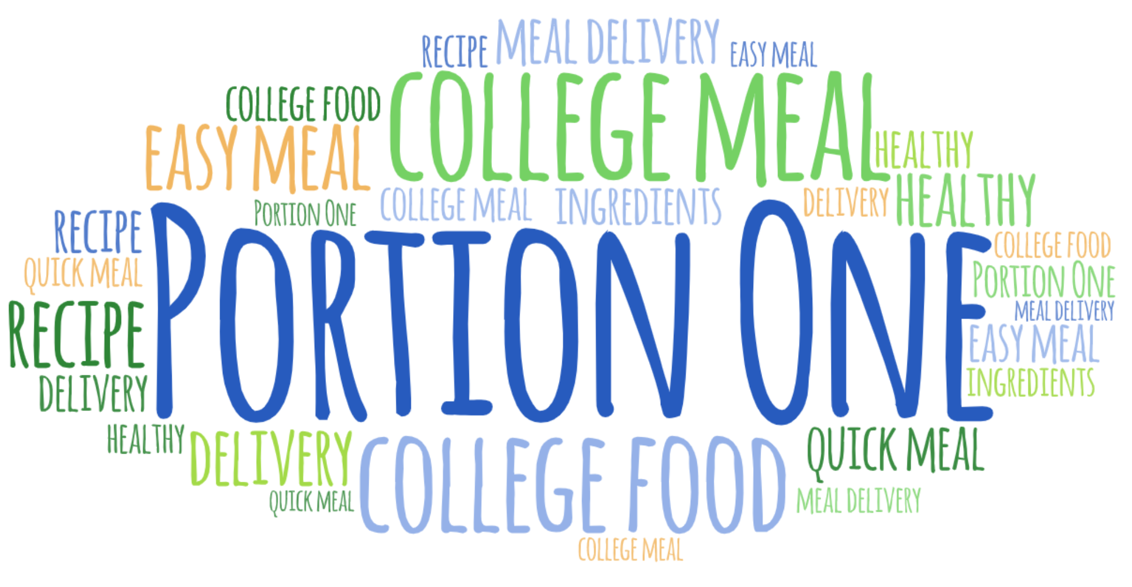
Keyword Analysis Process

Slide 5
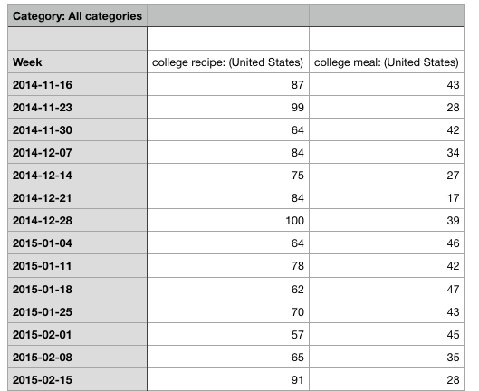
Keyword Analysis Example
College recipe
vs.
College meal

Slide 6
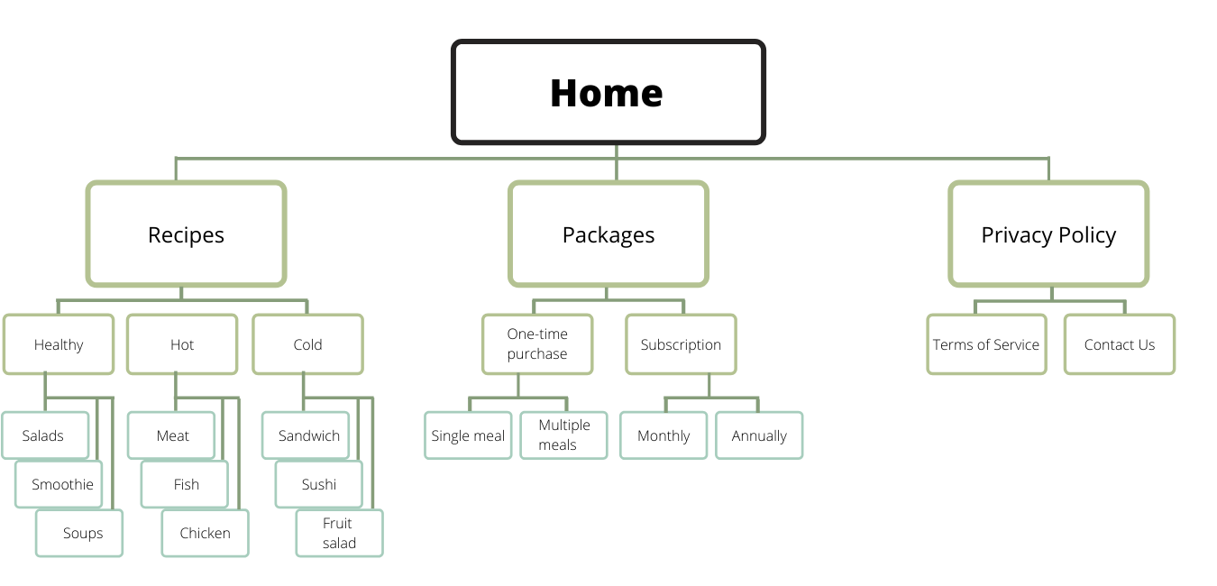
Keyword Distribution

Slide 7



Competition Analysis
Alexa, Google Keyword Planner and Similar web were both used to extract the data for the competition analysis.
Recipe and Meals are similar keywords to our other competitors.

Slide 8
Link Popularity/Traffic Visitor Activity
HelloFresh
Traffic/Visitor activity
Total visitors: 4.2M
Most traffic sources come directly from the URL.
Top referring sites: ticketmaster.com, stubhub.com, spirit.com, msn.com, groupon.com
Organic Keywords
Hello fresh
Hellofresh
Hello fresh login
Hello fresh menu
Hello fresh recipes
Paid Keywords
Hello fresh
Hellofresh
Blue apron
Freshly
Hello fresh menu
Three top social media traffic visits from: Youtube, Facebook and Pinterest.
Blue Apron
Traffic/Visitor Activity
Total visitors: 1.22M
Most traffic sources come directly from URL and searching the brand
Organic Keywords
Blue apron
Blueapron
Blue apron recipes
Blue apron menu
Blue apron login
Paid Keywords
Blue apron
Blueapron
Blue apron menu
Hello fresh
Three top social media traffic visits from: Youtube, Facebook and Pinterest.

Slide 9
HomeChef
Traffic/Visitor Activity
Total visitors: 19.5M
Most traffic comes directly from searching
Top referring sites: stubhub.com, groupon.com, tawsci.com
Organic Keywords
Home chef
Homechef
Homechef login
Home chef menu
Paid Keywords
Home chef
Homechef
Home chef menu
Blue apron
Top three social media: Facebook, Youtube, Pinterest

Slide 10
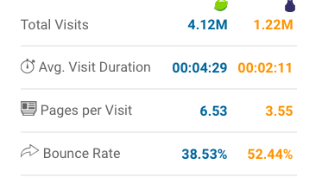
Takeaways
Importance of creating brand awareness - most traffic from our Competitors came direct sources/searches
Bounce rate: People stay on hellofresh longer than they do on blue apron.
On the keyword meal delivery and food they pop up either on the first or second page Food and food network

Slide 11
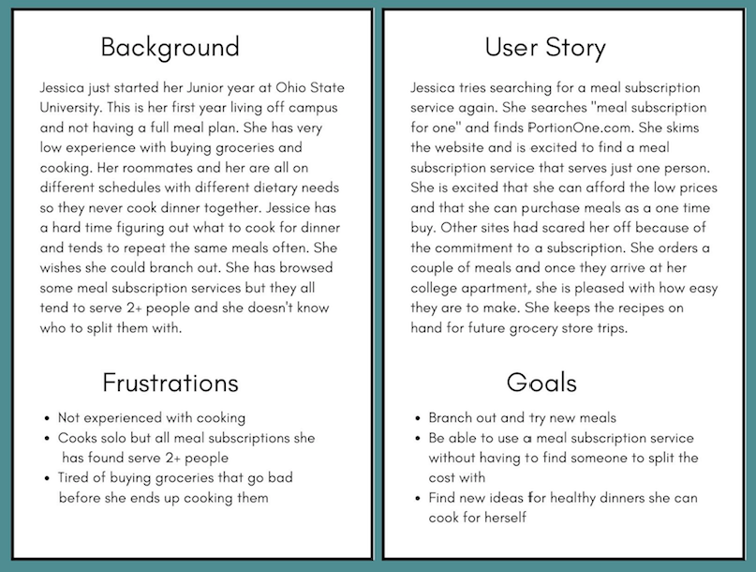
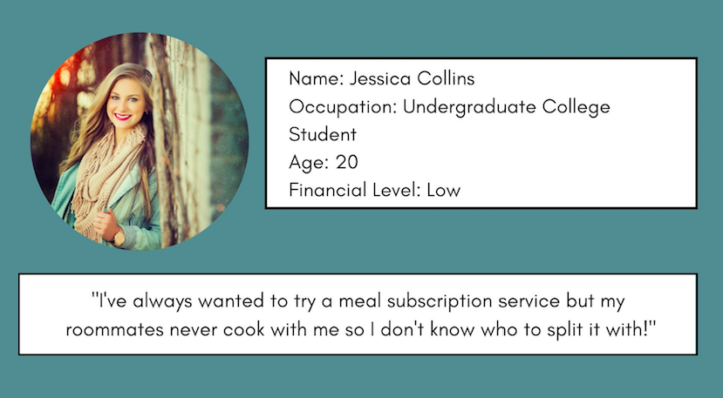
Persona 1

Slide 12
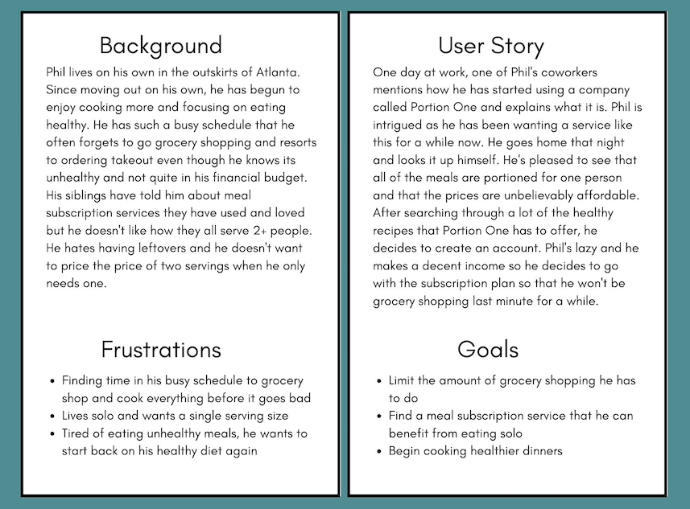
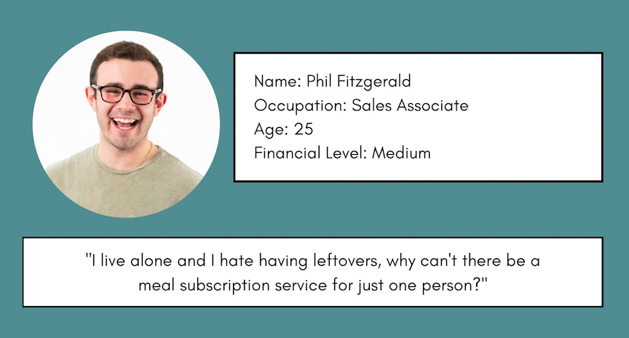
Persona 2

Slide 13
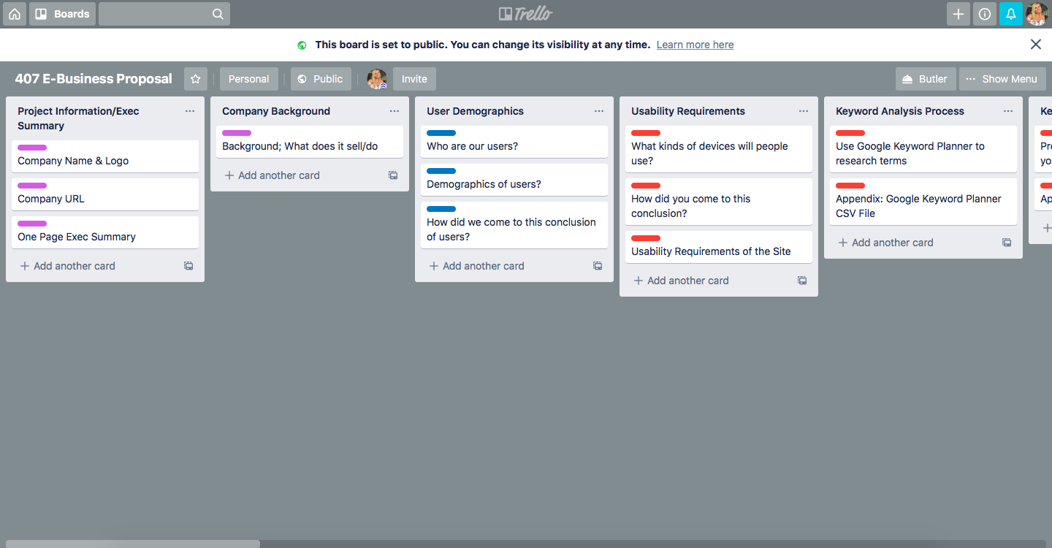
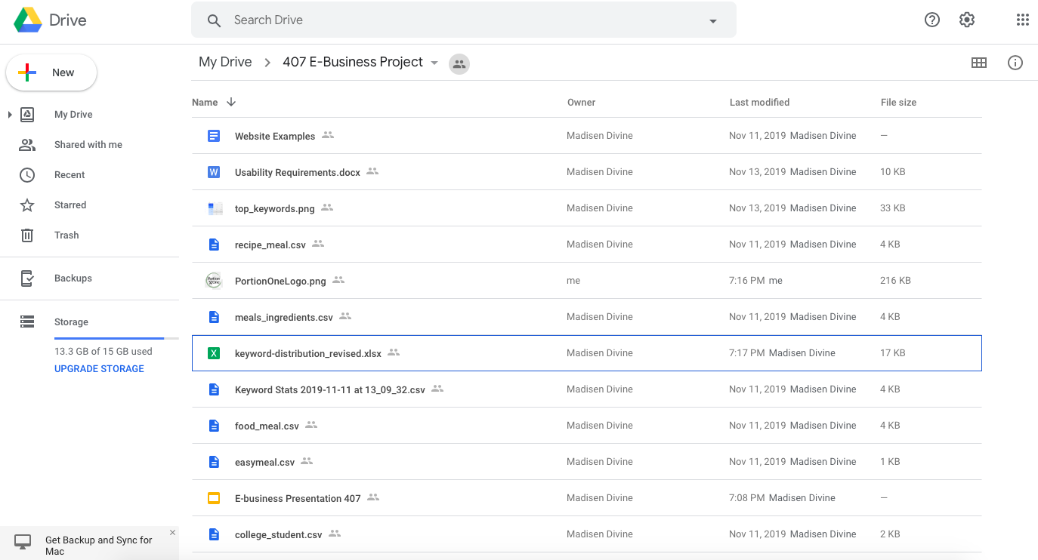
Project Management
Trello
Google Drive

Slide 14



Design Considerations
Optima
Arial Hebrew

Slide 15
Search Engine Optimization
Website & UX Design
Increase Users to Our Site
Optimize Key Words
“Healthy Meal Subscription Service for One Person”
Focus On Website Content

Slide 16
Online Marketing/Advertising
Target college kids, young adults and individuals living on their own
- Social Media
Facebook, Youtube and Pinterest were the highest social media outlets with our competitors.
Presence on Snapchat will set us apart.
display interactive ads that will show up on Snapchat’s feed.

Slide 17


Deliverables
Facebook Ad
Snapchat Ad

Slide 18
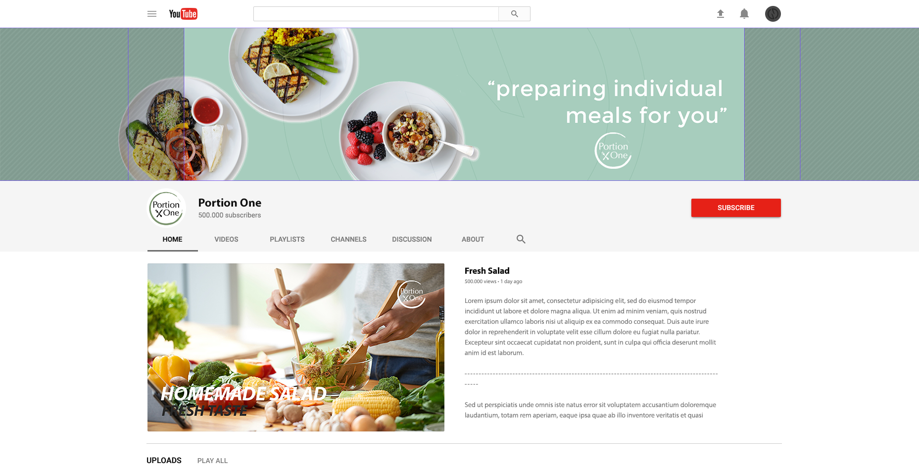
Youtube Page

Slide 19
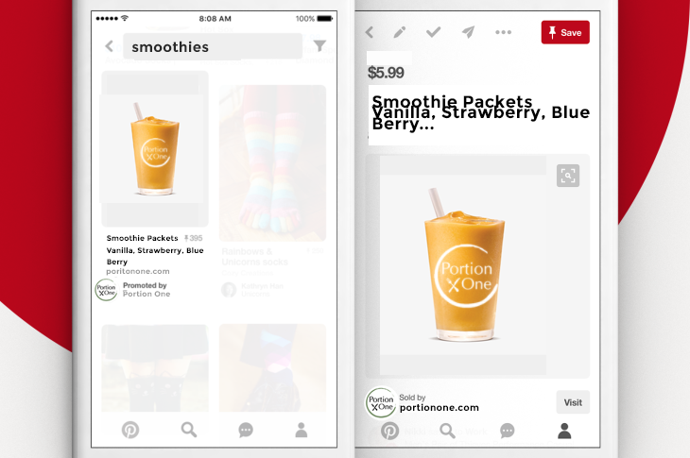
Pinterest Ad

Slide 20



Technology Selection

Slide 21

Hosting
Dedicated
We will be using both a store front and a shopping cart system.
Hot recipes, Cold Recipes, Smoothies - be able to place within the cart.
Will will not be using a contribution network due to not including videos. Our interface will just include images and date in regards to different meals for consumers.
We will handle our payments through Authorize.net

Slide 22
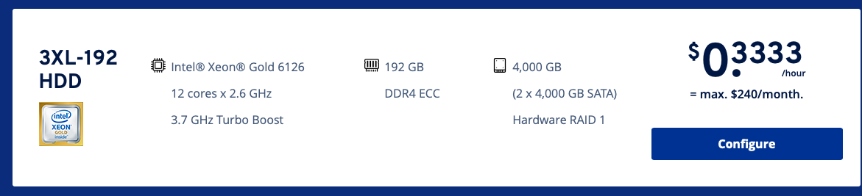
Hosting Package

Slide 23
User Demographics
People Cooking for Themselves
College Students
Young Adults
Anyone living on their own
Multiple Income Levels
Any race/gender

Slide 24
Privacy & Security
Login & User Account Pages will be SSL Encrypted
Accounts are protected by user-set passwords
Emails must verified with the user
Portion One intends to achieve a digital certificate as a trusted meal delivering company.

Slide 25
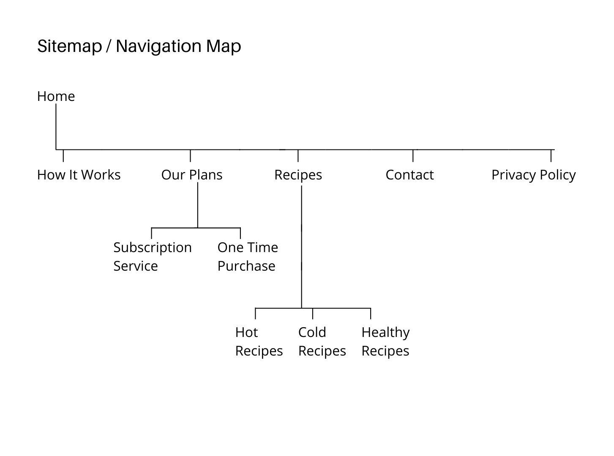
Website Structure

Slide 26
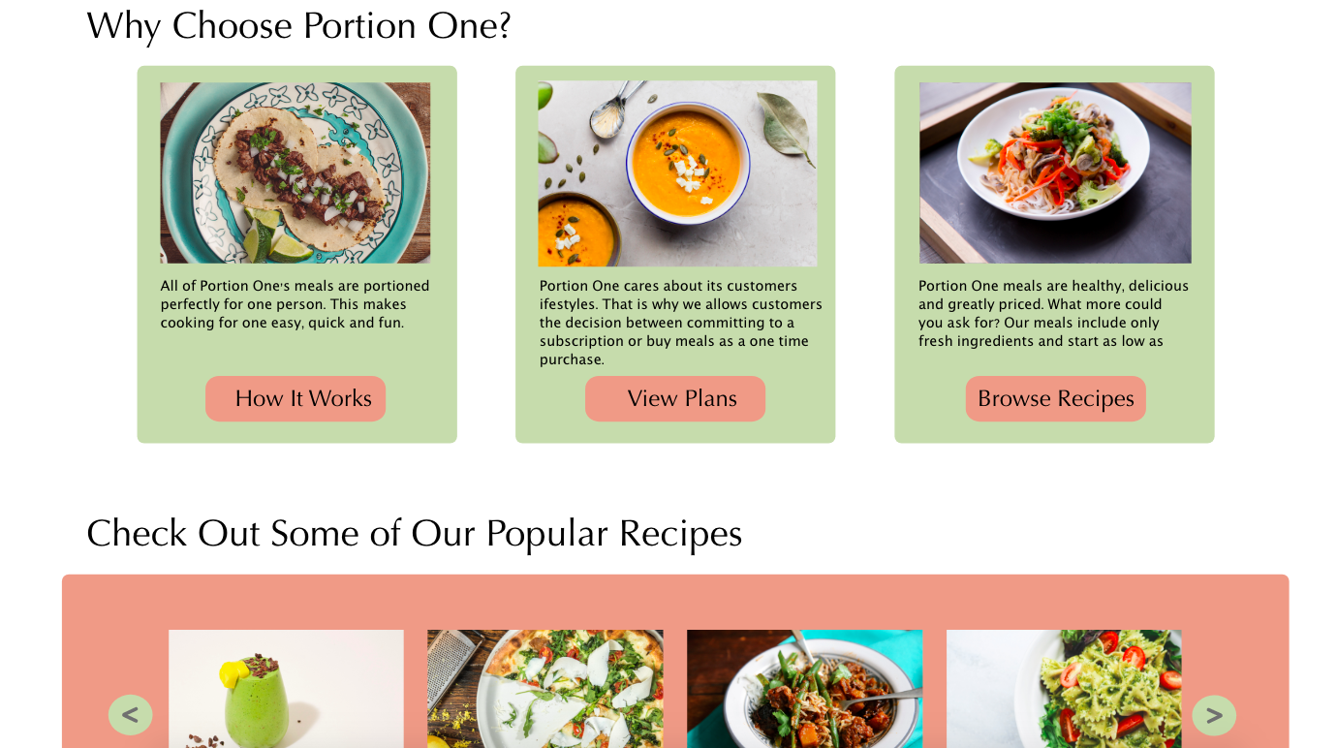
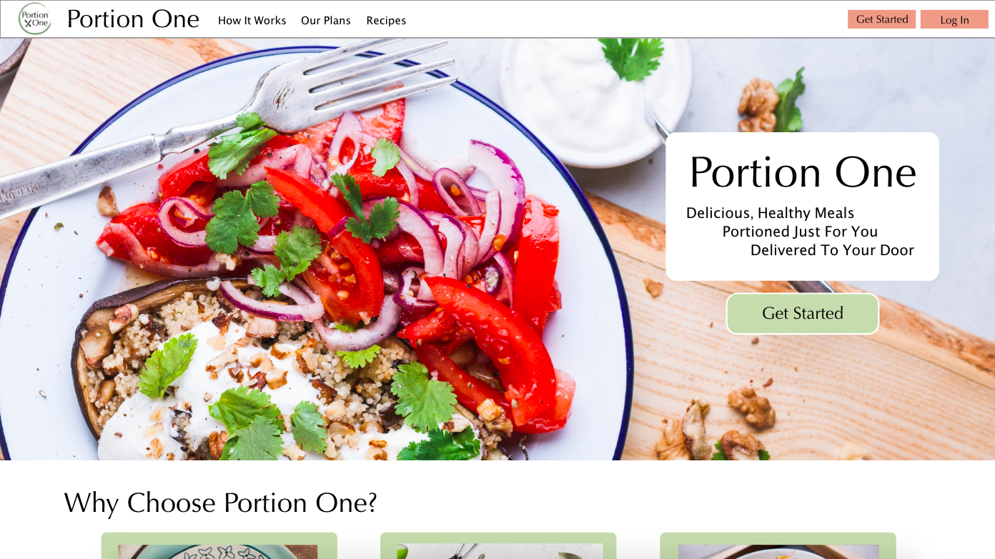
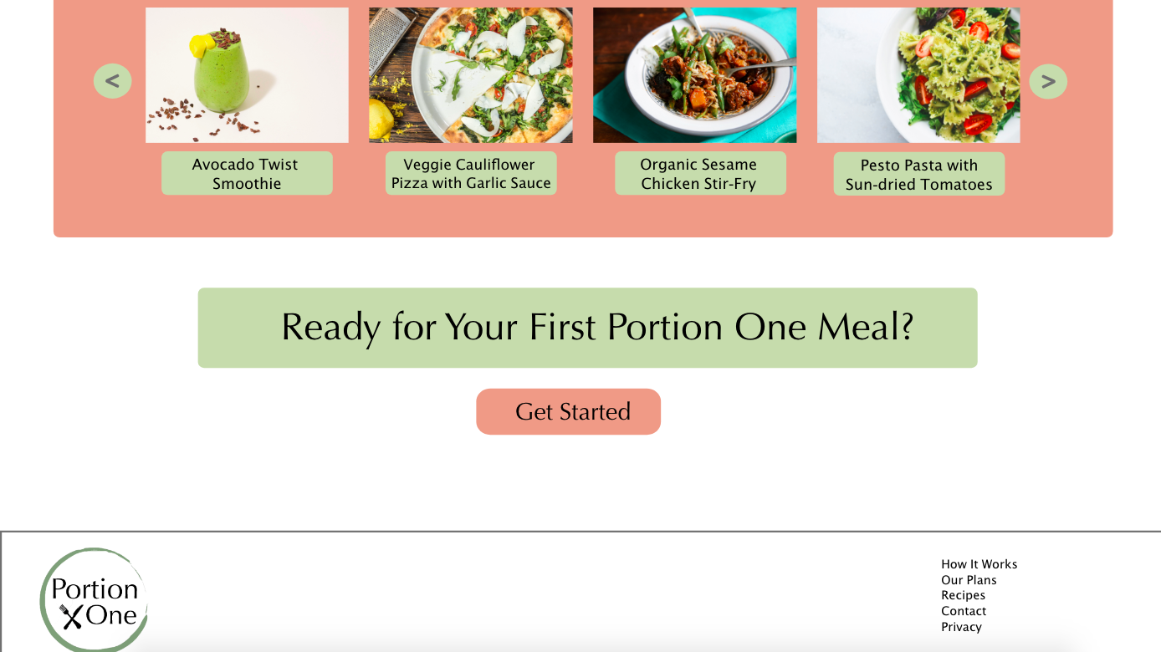
Home Page Mock Up
https://xd.adobe.com/view/7d519b4e-a82b-4e22-6ece-b2a82c6e41d0-0b60/screen/806b32c4-9e5f-4244-9e39-a3031f300256/Home-Page-Mock-Up

Slide 27
Usability Testing
Testing will be done in an individual city
Preferably a college town
We will launch in beta mode in a few particular spots that we consider potentially booming areas

Slide 28

Analytics
Keyword Distributions
Google Analytics

